Slide 1
Perceptual Image Enhancement for Smartphone Real-Time Applications (LPIENet)
BARAA ABED 88000
YOUSEF MUREB 88535
AHMAD AWWAD 88281
MOHAMMED ADNAN 89025

Slide 2
Introduction
Image Restoration refers to the process of improving the quality of an image.
Image Denoising
Removing unwanted noise from images
Image Deblurring
Removing image blur
HDR Reconstruction
Restoring details in very dark & bright areas of an image
Under-Display Camera (UDC) Image Restoration
Removing reflections and image artifacts

Slide 3
Problem Statement
Despite smartphone camera progress, issues persist. Current fixes, including deep learning, cannot run in real-time. A lightweight solution is needed to enhance photos in real-time on mobile devices.

Slide 4
Literature Review
Efficient Frequency Domain-based Transformers for High-Quality Image Deblurring [1]
Efficient and Explicit Modelling of Image Hierarchies for Image Restoration [2]
DeblurGAN-v2: Deblurring (Orders-of-Magnitude) Faster and Better [3]

Slide 5
Literature Review (Summary)
Model | PSNR (dB) | Parameters (M)
FFTformer [1] | 34.21 | 16.6
GRL-B [2] | 33.94 | 19.81
DeblurGAN-v2 (MobileNet-DSC) [3] | 28.03 | 0.922

Slide 6
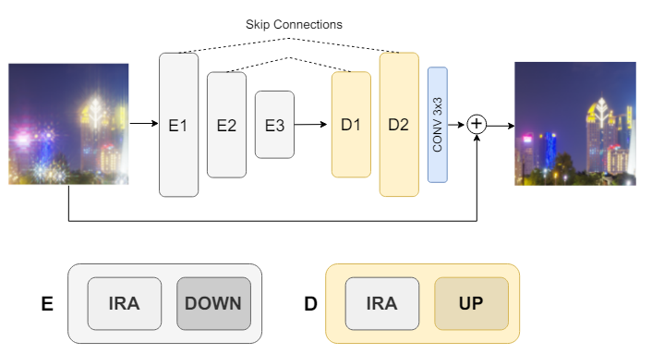
Methodology
LPIENet [4] by S. Nah et. al.
Follows the U-Net Architecture
5 blocks, (3 encoders and 2 decoders) with [16, 32, 64, 32, 16] channels respectively.
Uses inverted residual attention (IRA) blocks
Architecture of the proposed LPIENet network [4]

Slide 7
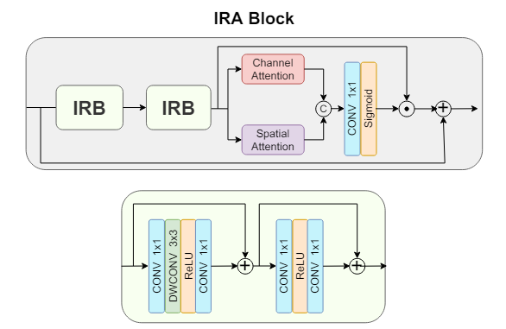
Methodology
The IRA blocks consist of:
2 Inverted linear residual blocks (IRB)
Attention block
Spatial attention
Channel attention
Architecture of the proposed IRA Block [4]

Slide 8
Dataset
GoPro dataset [5] by Nah et al.
3214 pairs of blurry and sharp HD images (1280x720)
Made by capturing 240 fps HD videos with a GoPro Hero4 Black camera
Averaging successive latent frames into one to produce the blurred image.
Sharp image is the mid-frame of the corresponding latent frames used.
2103 train pairs and 1111 test pairs
Notes:
“We used GOPRO4 Hero Black camera to generate our dataset. We took 240 fps videos with GOPRO camera and then averaged varying number (7 - 13) of successive latent frames to produce blurs of different strengths. For example, averaging 15 frames simulates a photo taken at 1/16 shutter speed, while corresponding sharp image shutter speed is 1/240. Notably, the sharp latent image corresponding to each blurry one is defined as the mid-frame among the sharp frames that are used to make the blurry image. Finally, our dataset is composed of 3214 pairs of blurry and sharp images at 1280x720 resolution.”
“GoPro [41] by Nah et al. is widely used in motion deblurring, for training and evaluation. It consists of 3214 pairs of blurry and sharp HD resolution images (1280 × 720). This is a synthetic dataset since the blurred images are produced by averaging several high-speed clean images. Following the standard practice [41], we use 2103 pairs for training and 1111 pairs for testing. During training we use random paired crops of size 540 × 960.”

Slide 9
Implementation
Data preparation
Center cropped images to 540x960
Scaled to [0,1]
Train size: 1683, Val Size: 420, Test Size: 1111
Adam optimizer with a learning rate of 0.0001
Xavier weight initialization
MSELoss
Batch size of 4
500 Epochs

Slide 10
Results
Model | PSNR (dB) | Parameters (M)
FFTformer [1] | 34.21 | 16.6
GRL-B [2] | 33.94 | 19.81
DeblurGAN-v2 (MobileNet-DSC) [3] | 28.03 | 0.922
LPIENet [4] | 27.80 | 0.13
LPIENet (Ours) | 26.88 | 0.13

Slide 11
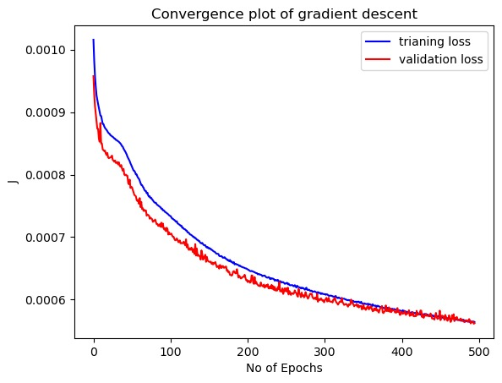
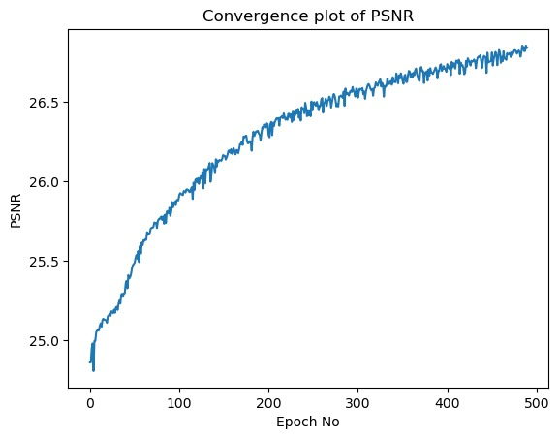
Results

Slide 12
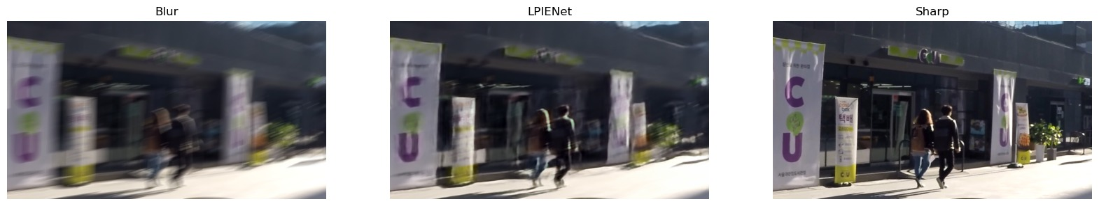
Performance evaluation

Slide 13
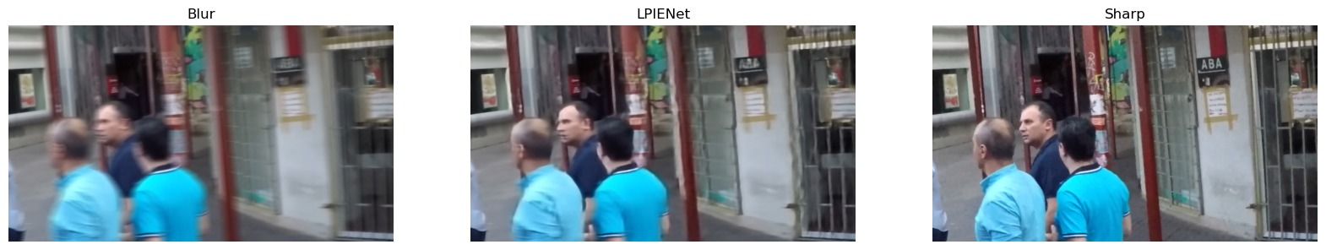
Performance evaluation

Slide 14
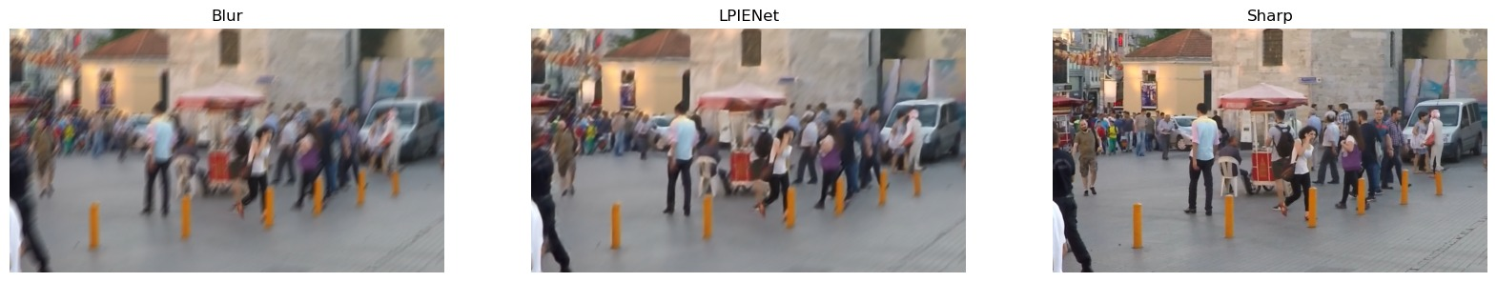
Performance evaluation

Slide 15
Discussion
Much less parameters but acceptable performance
Difference in PSNR between our project and the paper:
MSELoss instead of paper’s custom loss
No augmentation used due to time/computational limitations
Paper uses learning rate decay
Our loss still has not converged

Slide 16
Work Division
Ahmad Awwad: Code and Model testing, Presentation
Baraa Abed: Code development, GitHub organization, Recording, Model training/testing
Mohammed Adnan: Dataset loading code, Presentation
Yousef Mureb: Code development, Model training

Slide 17
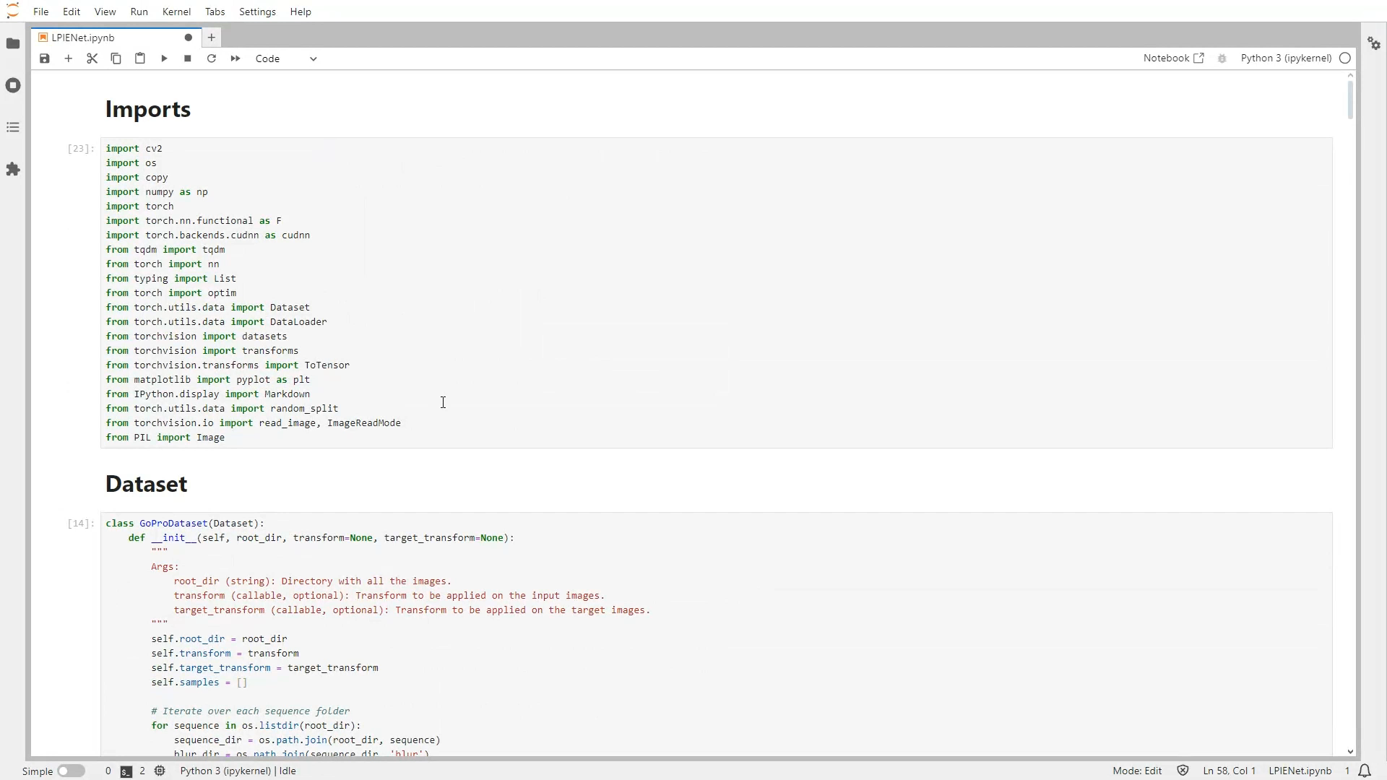
Demonstration

Slide 18
References
[1] L. Kong, J. Dong, J. Ge, M. Li, and J. Pan, “Efficient frequency domain-based transformers for high ...,” Efficient Frequency Domain-based Transformers for High-Quality Image Deblurring, https://openaccess.thecvf.com/content/CVPR2023/papers/Kong_Efficient_Frequency_Domain-Based_Transformers_for_High-Quality_Image_Deblurring_CVPR_2023_paper.pdf.
[2] Y. Li et al., Efficient and Explicit Modelling of Image Hierarchies for Image Restoration, https://openaccess.thecvf.com/content/CVPR2023/papers/Li_Efficient_and_Explicit_Modelling_of_Image_Hierarchies_for_Image_Restoration_CVPR_2023_paper.pdf.
[3] O. Kupyn, T. Martyniuk, and Z. Wang2, “DeblurGAN-V2: Deblurring (orders-of-magnitude) faster ...,” DeblurGAN-v2: Deblurring (Orders-of-Magnitude) Faster and Better, https://openaccess.thecvf.com/content_ICCV_2019/papers/Kupyn_DeblurGAN-v2_Deblurring_Orders-of-Magnitude_Faster_and_Better_ICCV_2019_paper.pdf.
[4] M. V. Conde, F. Vasluianu, J. Vazquez-Corral, and R. Timofte, “Perceptual image enhancement for smartphone real-time applications,” 2023 IEEE/CVF Winter Conference on Applications of Computer Vision (WACV), Jan. 2023. doi:10.1109/wacv56688.2023.00189
[5] S. Nah, T. Hyun, K. Kyoung, and M. Lee, “Deep Multi-scale Convolutional Neural Network for Dynamic Scene Deblurring,” 2018. Accessed: May 11, 2024. [Online]. Available: https://arxiv.org/pdf/1612.02177v2#page=3&zoom=100

